Slide 1
Annapurna: Building a Real-World Smartwatch based Automated Food Journal
Sougata Sen; Vigneshwaran Subbaraju; Archan Misra, Rajesh K Balan and Youngki Lee
Singapore Management University, Singapore

Slide 2
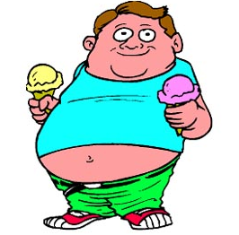
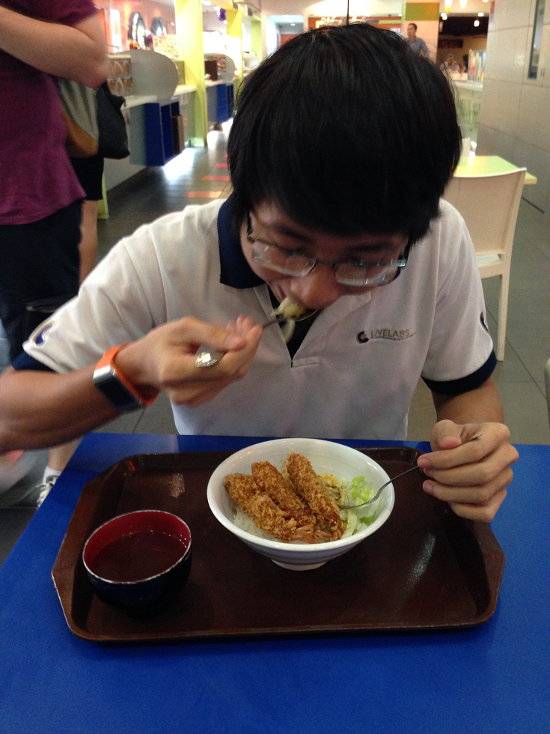
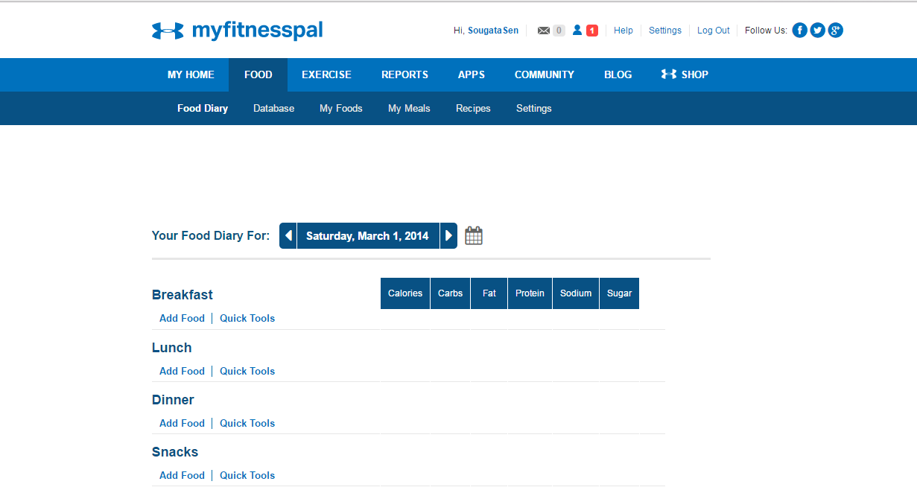
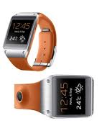
NEED FOR AUTOMATED FOOD JOURNALING
Gesture Recognition : Accelerometer + Gyroscope
Image Capturing : Camera
Obesity
Diseases
Mood
Johnson, Richard J., et al. "Hypothesis: could excessive fructose intake and uric acid cause type 2 diabetes?." Endocrine reviews 30.1 (2009): 96-116.
Shanthy A. Bowman & Bryan T. Vinyard (2013) Fast Food Consumption of U.S. Adults: Impact on Energy and Nutrient Intakes and Overweight Status, Journal of the American College of Nutrition, 23:2, 163-168, DOI: 10.1080/07315724.2004.10719357
http://www.myfitnesspal.com/
Hill, Andrew J., Claire FL Weaver, and John E. Blundell. "Food craving, dietary restraint and mood." Appetite 17.3 (1991): 187-197.
2
Notes:
The correlation between different food consumption and its effect on obesity is a commonly studied topic. However, the correlation between food consumption and obesity is not the only studied topic.

Slide 3
ANNAPURNA: EATING ANALYTICS SYSTEM
Goals:
Unobtrusively capture both the eating activities of a user AND the food that she consumers
Provide users with a personalized portal showing the food consumption patterns
End-use cases:
Diet monitoring: self-awareness
Real-time alerts: unhealthy eating habits
Eating forensics: diagnose allergy causes in children
3

Slide 4
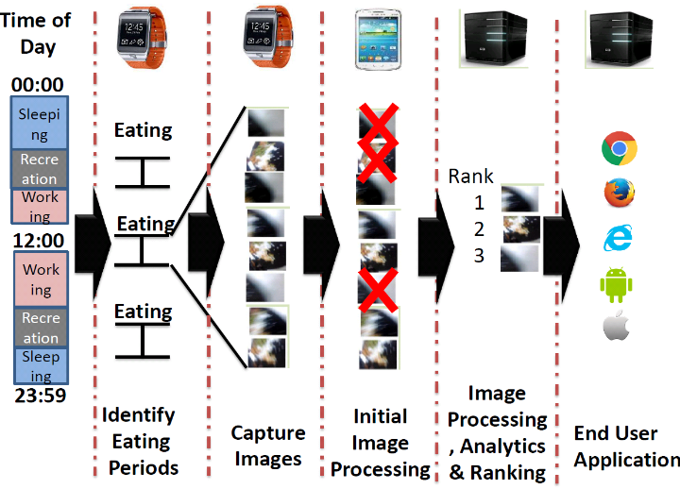
ANNAPURNA: PIPELINE
4

Slide 5
ANNAPURNA: Feasibility Study Details
21 Participants
13 male, 8 female
5 nationalities
Sensor Data Collected
Accelerometer
Gyroscope
Continuous Image frames
135 episodes
66 rice (211 to 1140 sec)
20 sandwich (255 to 363 sec)
29 pasta/noodles (234 to 711 sec)
20 sliced fruits (51 to 387 sec)
Food Item | Completion Time (Seconds) |  |  | Hand to Mouth Gestures (count)
 | Min | Max | Avg | Min | Max | Avg
Rice (~100 gms) | 211 | 1140 | 568 | 22 | 54 | 33.5
Sandwich | 255 | 363 | 299 | 6 | 35 | 14.4
Pasta/ Noodles | 234 | 711 | 459 | 13 | 35 | 27.3
Fruits (~15 pieces) | 51 | 387 | 183 | 7 | 23 | 13.5
Episodes Video Recorded for Ground Truth
Sen, S., Subbaraju, V., Misra, A., Balan, R. K., & Lee, Y. (2017, June). Experiences in Building a Real-World Eating Recogniser. In 4th International Workshop on Physical Analytics (WPA 2017, collocated with Mobisys), 2017 ACM
5

Slide 6
ANNAPURNA: Gesture Recognition
135 Episodes
Hand-to-Mouth
Gesture
Hand-to-Mouth Gesture
Data Extraction
Non Hand-to-Mouth Gesture
Details of the gesture recognizer can be found in “Sen, S., Subbaraju, V., Misra, A., Balan, R. K., & Lee, Y. Experiences in Building a Real-World Eating Recogniser. In 4th International Workshop on Physical Analytics (WPA 2017, collocated with Mobisys), 2017.”
Other similar to eating gestures
Feature Extraction
Feature Extraction
Model Building
Model Used in the
real-world studies
6

Slide 7
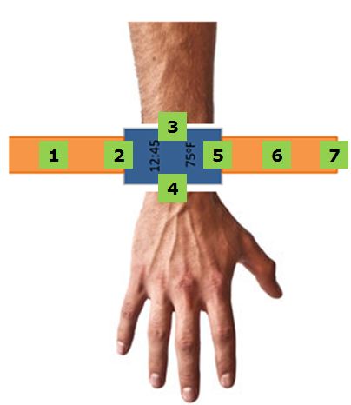
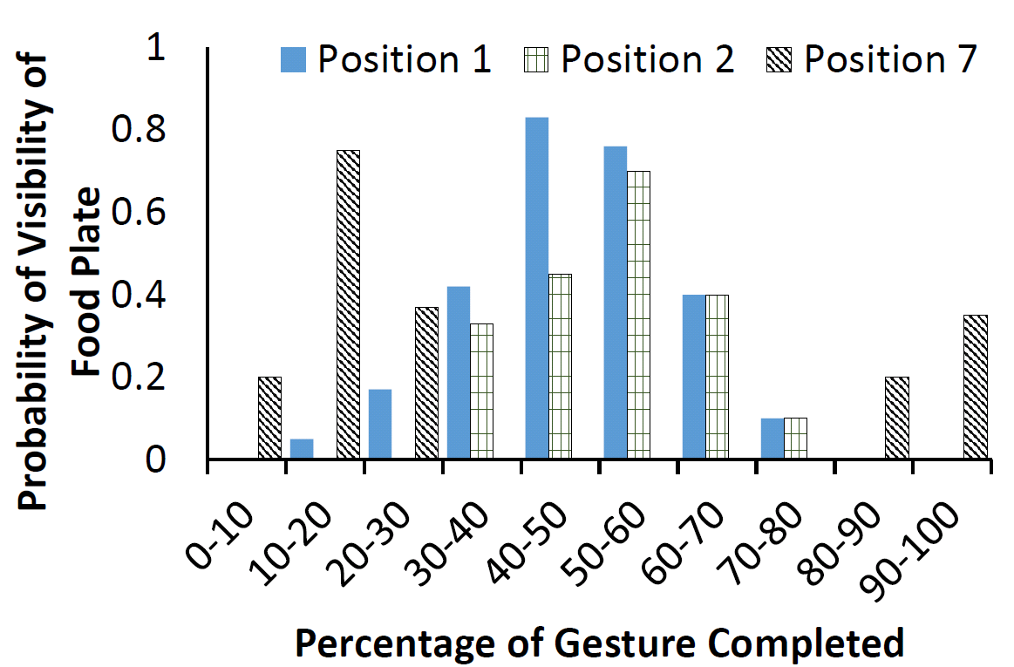
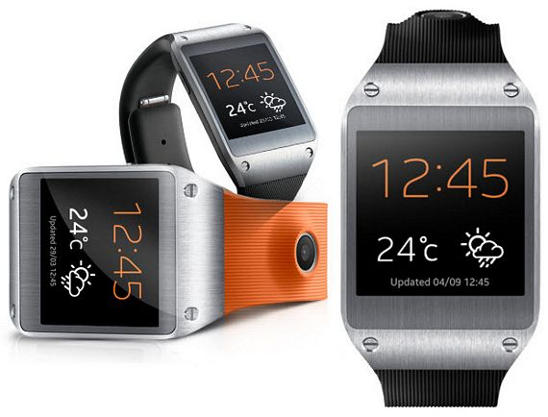
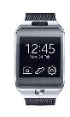
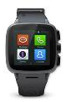
POSSIBILITY OF CAPTURING IMAGES
Feasibility vs. Camera Position
7 Distinct
Positions
Considered
2 male participants
15 rice eating episodes
Samsung Gear 1
Positions 1,6,7
Samsung Gear 2
Positions 2, 5
Omate TrueSmart
Positions 3,4

Slide 8


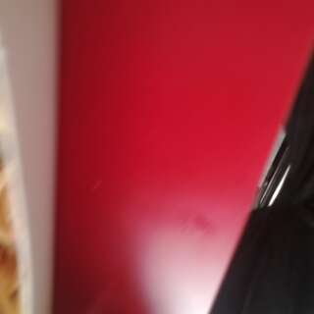

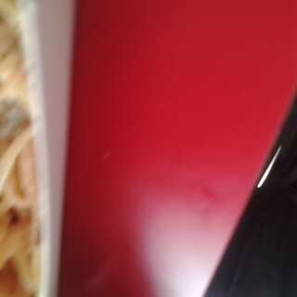
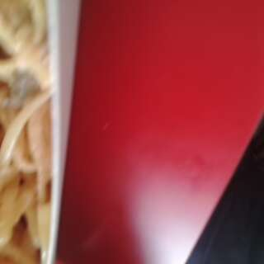
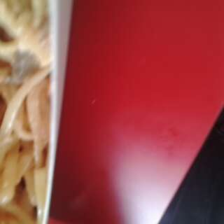
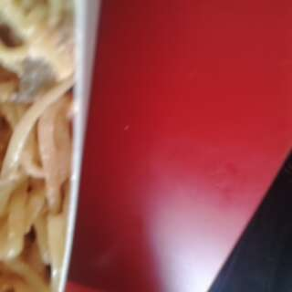
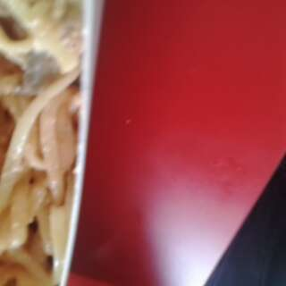
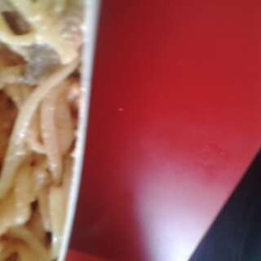
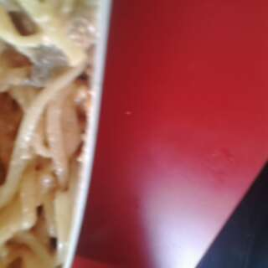
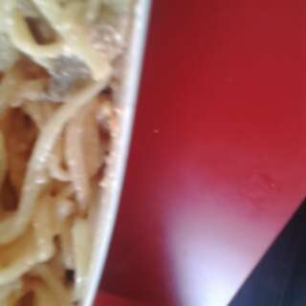
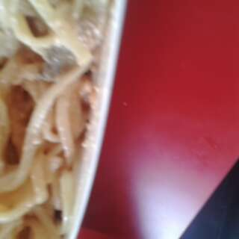
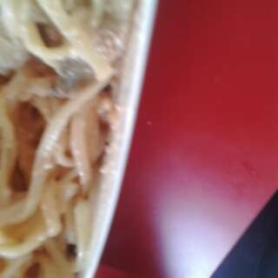
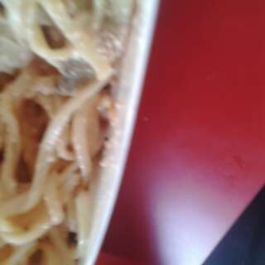
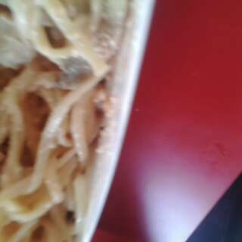
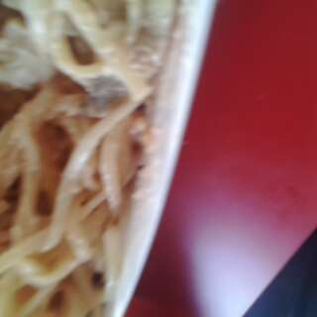
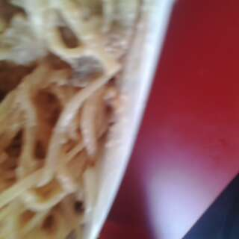
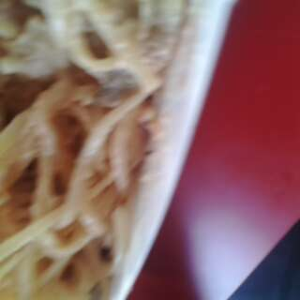
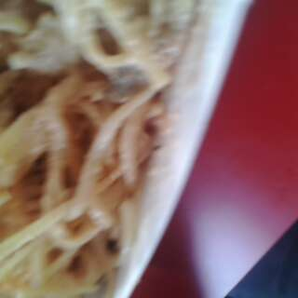
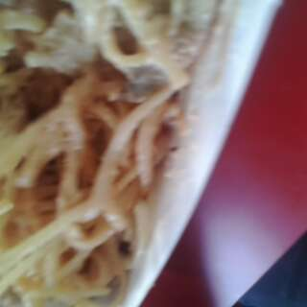
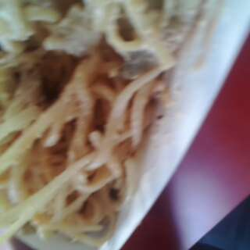
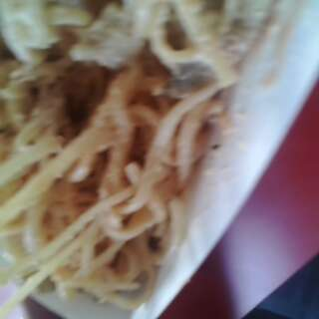
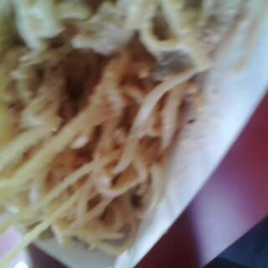
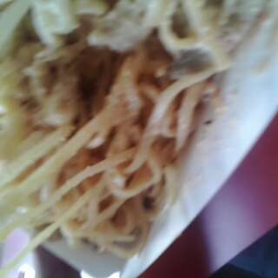
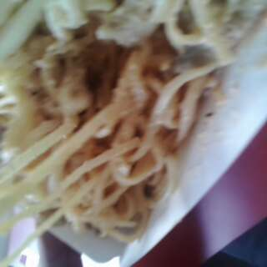
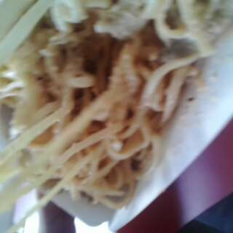
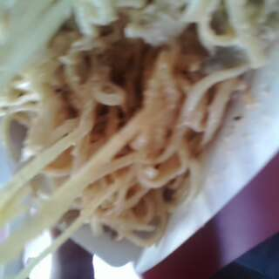
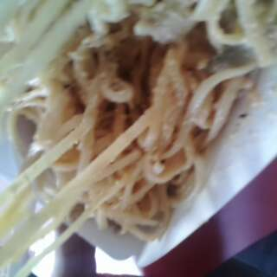
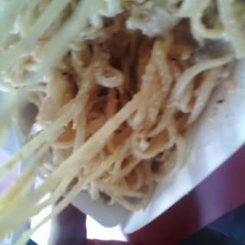
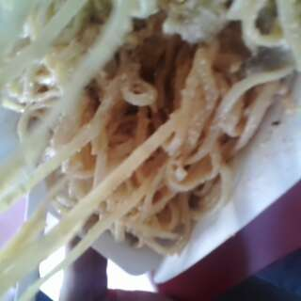
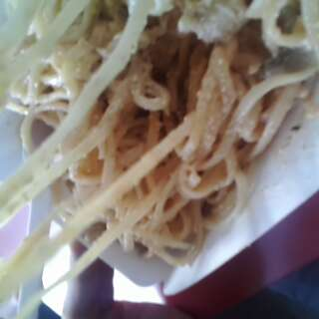
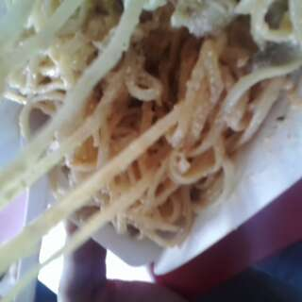
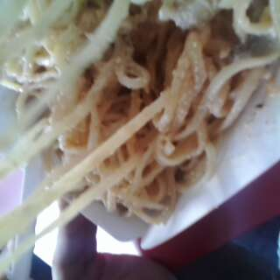
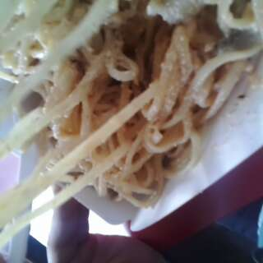
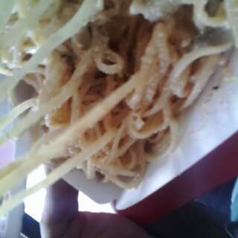
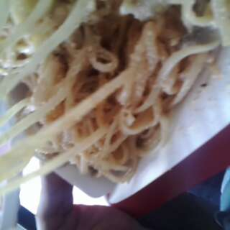
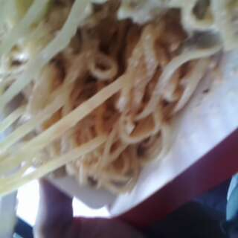
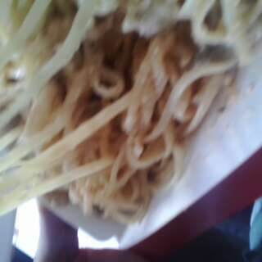
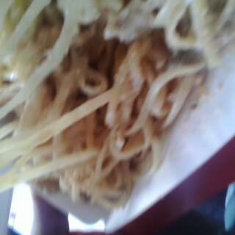
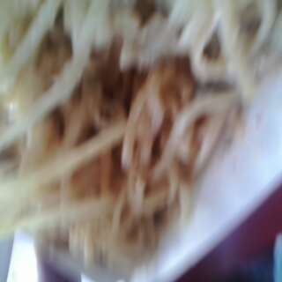
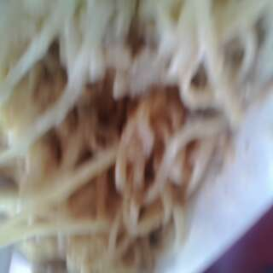
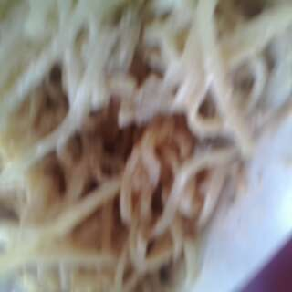











Examples of images captured: 1 gesture
8

Slide 9

























THE IMAGE PROCESSING PIPELINE
Best Images For entire Episode
Edge Detector
Plate Area Detector
Foreground Detection
Verifier
Image Ranker
Display to User
Sen, S., Subbaraju, V., Misra, A., Balan, R. K., & Lee, Y. (2018, June). Annapurna: Building a Real-World Smartwatch-based Automated Food Journal. 19TH IEEE International Symposium on a World of Wireless, Mobile and Multimedia Networks (WoWMoM 2018) – To Appear
9
Notes:
Filtering Step (921617 Images) Device % of Images remaining
Total images captured Watch 100
RGB Variance & Face Count Phone 88
Edge Count Filter Server 37
Plate Shape Filter Server 6.6
Depth Map & CNN based Filter Server 0.8

Slide 10



IMAGE CAPTURE CONSIDERATIONS
How Long to Capture?
Good Image Probability _{k} $=\frac{\sum{good image for k }}{Total Episodes}$
P → Number of Images
Good Image Prob.
Continuously, Till-K gestures
Good Image Prob.
Intermittently, During gestures
Approx. 135 seconds
Approx. 40 seconds
Number of Gestures
Number of Gestures

Slide 11

Final web application
11
Notes:
(2 public seating areas, 3 food courts, and 2 restaurants)
buns, rice cakes, rice with curry, pasta, and salad
Age group → 24 to 34

Slide 12
STUDIES in daily life settings
Study Details
Total number of Studies: 4
Studies with stable gesture recognizer: 2
Total Participants : 9
Number of days of data: 46
System Performance
Number of Meals Reported (Ground Truth): 81
Number of meals Identified (TP) : 77
Wrongly Identified meals by Gesture recognizer (FP initial): 45
False Positives corrected by the Image Recognizer: 41
Precision : 95%
Recall : 95%

Slide 13

Word cloud with study details
Word-cloud: in-the-wild eating

Slide 14
Summary
We presented the Annapurna system for automated food journaling.
We showed the possibility of capturing images of food using an embedded smartwatch camera
We presented the image filtering approach to remove false images
We showed that Annapurna is robust in identifying images of food in daily life setting – it can achieve a precision and recall of 95%.

